Slide 1
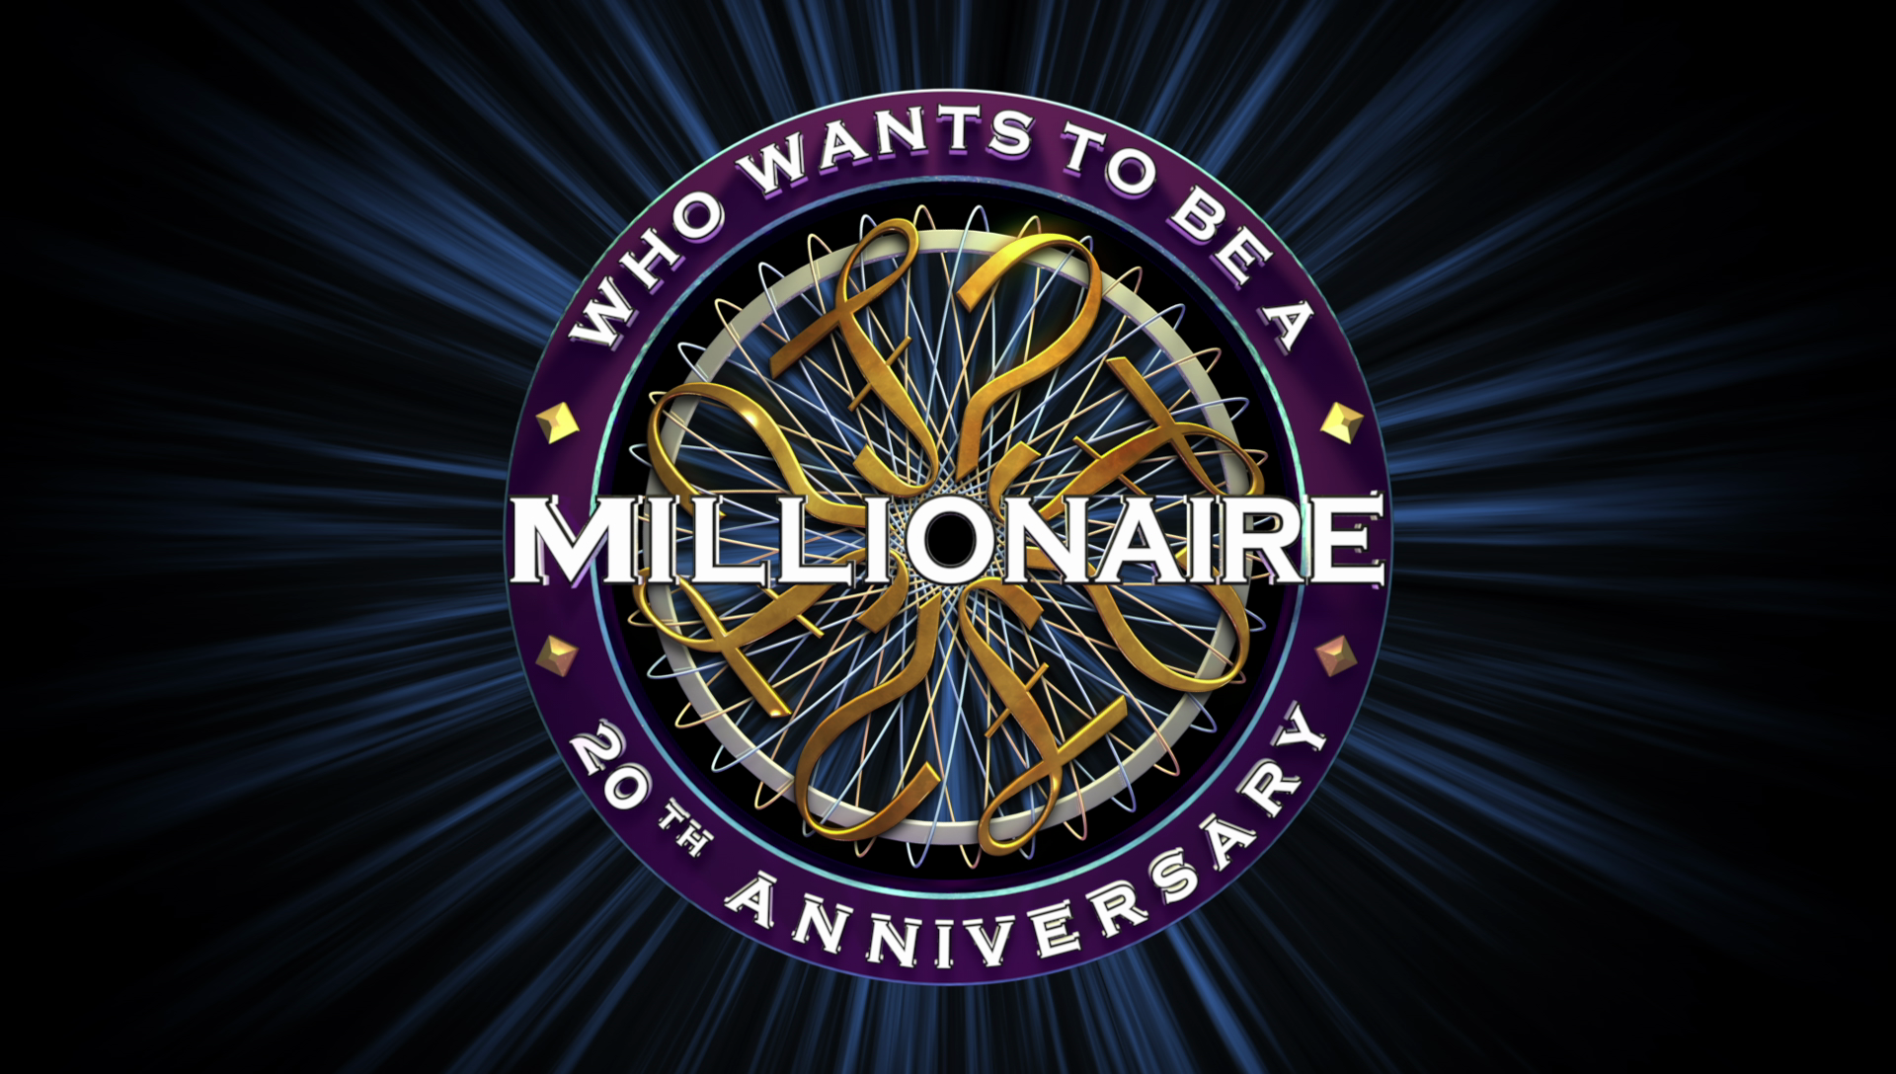

Slide 2
Where is Mount Everest?
Japan and Nepal
India and China
China and Nepal

Slide 3
Where is Mount Everest?
Japan and Nepal
India and China
China and Nepal

Slide 4
Which natural wonder is in the USA?
the Grand Canyon
the Stone Forest
the Amazon Rainforest

Slide 5
Which natural wonder is in the USA?
the Grand Canyon
the Stone Forest
the Amazon Rainforest

Slide 6
What is the Great Barrier Reef made of?
fish
coral
plants

Slide 7
What is the Great Barrier Reef made of?
fish
coral
plants

Slide 8
Which is the tallest waterfall on Earth?
Niagara Falls
Victoria Falls
Angel Falls

Slide 9
Which is the tallest waterfall on Earth?
Niagara Falls
Victoria Falls
Angel Falls

Slide 10
Where is Ayers Rock?
Africa
Australia
South America

Slide 11
Where is Ayers Rock?
Africa
Australia
South America

Slide 12
What is Mount Etna?
a volcano
a cave
a waterfall

Slide 13
What is Mount Etna?
a volcano
a cave
a waterfall

Slide 14
What is another name for aurora
borealis?
the Southern Lights
the Eastern Lights
the Northern Lights

Slide 15
What is another name for aurora
borealis?
the Southern Lights
the Eastern Lights
the Northern Lights

Slide 16
Which is the largest river in the world?
the Nile
the Amazon
the Danube

Slide 17
Which is the largest river in the world?
the Nile
the Amazon
the Danube

